Slide 1

Winter Progress Report CS462 Senior Capstone
Devin Foulger, Bryan Liauw, and Hector Trujillo
Notes:
This is our presentation for the winter progress report for our Android application. This project is being sponsored by eBay’s mobile development team. Our team name is 4Credit and we consist of three team members: Devin Foulger, Bryan Liauw, and Hector Trujillo. Our application, UniversityGear, will allow users to purchase college merchandise.

Slide 2
Project Description
EBay recently created multiple APIs that allow online retailers to start their stores or applications
APIs will be released to the public soon which will allow third party developers to create their own eBay applications
EBay would like us to test up to three of their APIs by creating an application that demonstrates their use. The application will consist of college merchandise
It will allow users to search for and purchase merchandise related to any college and will target the new Android operating system, N OS
The goal for eBay is that their APIs are tested and well documented for later use by other third party developers and to get more eBay related apps onto the Google Play store
Notes:
eBay recently created multiple APIs that allow online retailers to start their business easier. These APIs will be released to the public soon which will allow third party developers to create their own eBay applications. So, in order to test the applicability, eBay would like us to test up to three of their APIs by creating an application that demonstrates the APIs use. The application will consist of college merchandise. It will also allow users to search for and purchase merchandise related to any college and will target the new Android operating system, N OS. The goal for eBay is that their APIs are tested and well documented for later use by other third party developers and to get more eBay related apps onto the Google Play store.

Slide 3
Project Recap Winter Term
Week 1: During week 1, we talked about when we were going to meet to do some paired programming. We also uploaded our blank Android project to GitHub to get started.
Week 2: This week we accomplished creating our search activity, however the class does not currently work with eBay's APIs.

Slide 4
Project Recap Winter Term
Week 3: For this week, we were able to get eBay's search API integrated with our search class allowing for us to make searches. On top of that, we also started the list view activity and the item class. The item class will allow us to create items in any class. The list view allows us to view the items by using a recycler view

Slide 5
Project Recap Winter Term
Week 4: During week 4, we have been connecting everyone's pieces. This means that we can now go from searching to the list view correctly displaying search results. The list view correctly displays the title, image, and price of the item. The item class is also continually being added to, depending on what new variables we will be needing.

Slide 6
Project Recap Winter Term
Week 5: This week, we have been updating the search activity to apply filters. It will also now only select BIN items and specific colleges. The single item view has also been completed. The user can now select an item from the list view to view in full detail in the single item view. This used eBay's API to get the correct information on a specific item. The item class has also been updated to handle many of the given fields for a single item.

Slide 7
Project Status
We have developed over half of our application. So far, we have implemented the ability to search, view, and select single items.
Notes:
We have developed over half of our application. So far, we have implemented the ability to search, view, and select single items. This alone is a large part of the project. In the coming weeks, users will be able to purchase items, as well as use several filters to find the items that they need. These classes we have created also interact with eBay's APIs. So far, we have used their Browse API, but now we are going to be using the Order API to allow users to purchase the items that they want.

Slide 8
Notification Development
Notify user when no results found
Progress Bar
Notes:
We were able to implement the Alert notification that lets the user know that their keyword/s did not return any results. This message is important because it lets the user know that the application is working as it should, and there were simply no items containing the keywords or filters hat they used.
We were also able to setup the progress bar that keeps the user informed that the application is working on retrieving their search results.
These notifications are simple but important because they signal the user that the app is functioning and hasn’t crashed.

Slide 9
Search Activity Development
Search activity is divided into 2 parts, one consists of filtering prior to taking in user’s keywords input.
Filter is done using multiple checkboxes, buttons as well as text box.
User’s keyword is fixed through Levenshtein Algorithm
Despite the existence of this algorithm, the lack of word bank makes it practically obsolete
User input is passed into eBay’s Browse API which utilizes HTTP method to communicate with the servers
Return JSON array that will be used for other activities
Basically this activity is at its beta state

Slide 10
OAuth key Retrieval
Part of the search activity
Should probably changed how this works since other activities need to do this too
Uses similar method: HTTP requests for a key
Key is essential because new authentication is required every several days.
Uses base64 encoding for authentication that is required to retrieve the key

Slide 11
Item Class Development
The item class is what allow us to build specific items or a list of items
Uses JSON
Builds an item list
Build single items
Notes:
The item class is what allow us to build specific items or a list of items. First, the class will create a list of items that will be displayed to the user in a list item view. Once an item is selected from the list, the item class will build another single item, with much more information pertaining to the item selected. Development for this class is something that will be ongoing throughout the project. This is because more information may need to be grabbed depending on what kind of item is being selected. However, development was rather straight forwarded, as we grabbed the specific information we needed.

Slide 12
List View Development
User Interface (UI)
Scroll through results
Present major details
Notes:
We completed development of the Item List View.
This included the user Interface for the item list view where we used a simple design that matched the rest of the application.
The list view lets the user scroll through their search results in a user friendly manner.
This list view displays the item's title, image, and price for every item that is returned. This allows the user to scroll through the different items until they find one that catches their attention.

Slide 13
Single Item Activity
The single item activity class is what the users use to view the single item they have selected
This activity will display the pertinent information of an item, like its title, color, price, description, material, pattern, and any other item specific information
Uses eBay’s browse API
Notes:
The single item activity class is what the users use to view the single item they have selected. This activity will display the pertinent information of an item, like its title, color, price, description, material, pattern, and any other item specific information. This class made use of eBay's Browse API. Specifically, it used the get item method, which retrieves data for a given item.

Slide 14
Blockers and Solutions
Late Start
Familiarity with tools
No major consequences
Notes:
Initially, we had hoped to get started on the project during winter break. However it was hard finding the motivation to work on items that weren't required during our time off.
We had also hoped to become familiar with the tools that we would be using for this project. This included getting familiar with eBay's APIs and how to use them. As well as getting even more familiar with Android Application development, and some of the technologies that we were planning on using.
The failure to work on these goals during the break, didn't have a major impact on the project. It did slow down development a bit as we familiarized ourselves with the technologies being used. However, this was an issue that we were able to overcome as the term progressed.

Slide 15
Known Bugs
Images incorrectly displayed in List View
Images in list view vs item view
Bad Search Keywords
Notes:
There are three known bugs that we are currently working on resolving.
The first has to do with the way images are being presented within the current list view results. There are images that are cropped out because they are either too big or are in portrait mode. Ensuring that the images fit into their designated area on the screen will be important so that the users can see the entire image and thus get a good idea of the product that is for sale.
There is also a bug in the list view results display that we need to track down and fix. The bug results in images not displaying at all when the user is viewing the search results in a list view. However, the image displays correctly in the single item view. The part that makes it harder to identify is the fact that this bug is only present when working in the sandbox environment. When testing the application on eBay’s production servers, the images display properly on both the list view and single item view. It could come down to being an issue with the data in eBay’s sandbox environment. To determine this, we will need to do plenty of testing, and discuss with our client the potential causes for the different behavior in the different environments.
Lastly, there is a known bug that presents itself when the user submits bad search keywords. This bug appears by crashing the application. We will need to be able to handle bad input text from the user. This will involve either correcting their typing errors or ensure that the app doesn't crash when there are no results due to bad input and use the no search result notification to encourage the user to try again.

Slide 16
Remaining Tasks to Accomplish
Item filter development
Internet connectivity
Purchase class development
Notes:
This slide should go to who ever is going to talk about item class development

Slide 17
Internet Connectivity Verification
No Connection to eBay’s database
Application is useless without internet
Alert Notification
Notes:
Another small, but feature item that still needs to be implemented is to have the application check to ensure an active internet connection. Without an active internet connection the application will not be able to connect to eBay's database to retrieve results for the items that have been searched for. Essentially, without an internet connection, the application is useless.
If the user does not have an active internet connection, we will display an alert stating that a connection to the internet is a requirement for using the application.

Slide 18
Purchase Class Development
One of the larger classes, the purchase class, still needs to be developed before the end of the term
This class is what will allow users to purchase an item of their choice
Uses eBay's Order API
Notes:
One of the larger classes, the purchase class, still needs to be developed before the end of the term. This class is what will allow users to purchase an item of their choice. In order to implement this class, we will need to use eBay's Order API. The Order API allows us to use guest checkout, meaning that any user will be able to use our app without a log in.

Slide 19
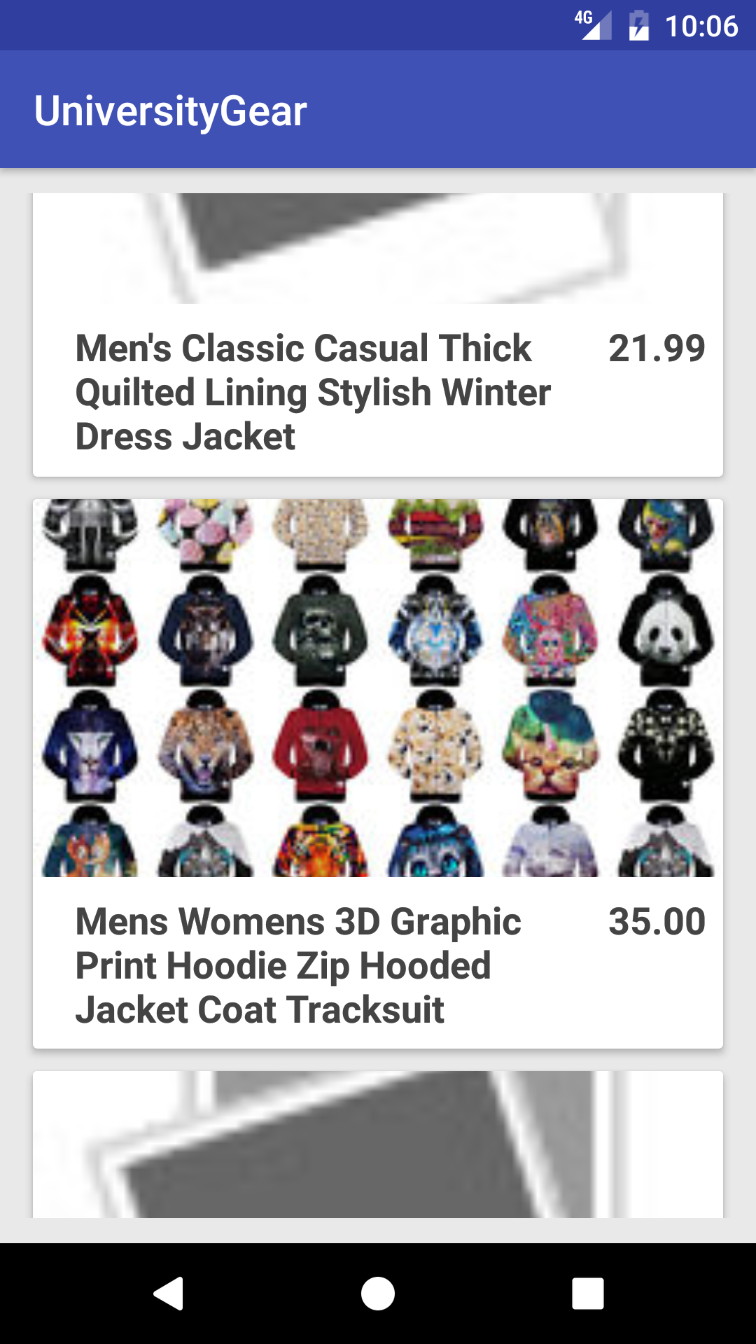
Image of the list view
Notes:
This is what the item list view looks like. This page is given to the user after they have search for an item. In this case, we have searched for a jacket. You’ll notice that each item has an image, price, and title. The user will be able to scroll up and down to view any of the items that have been returned from the search results.

Slide 20
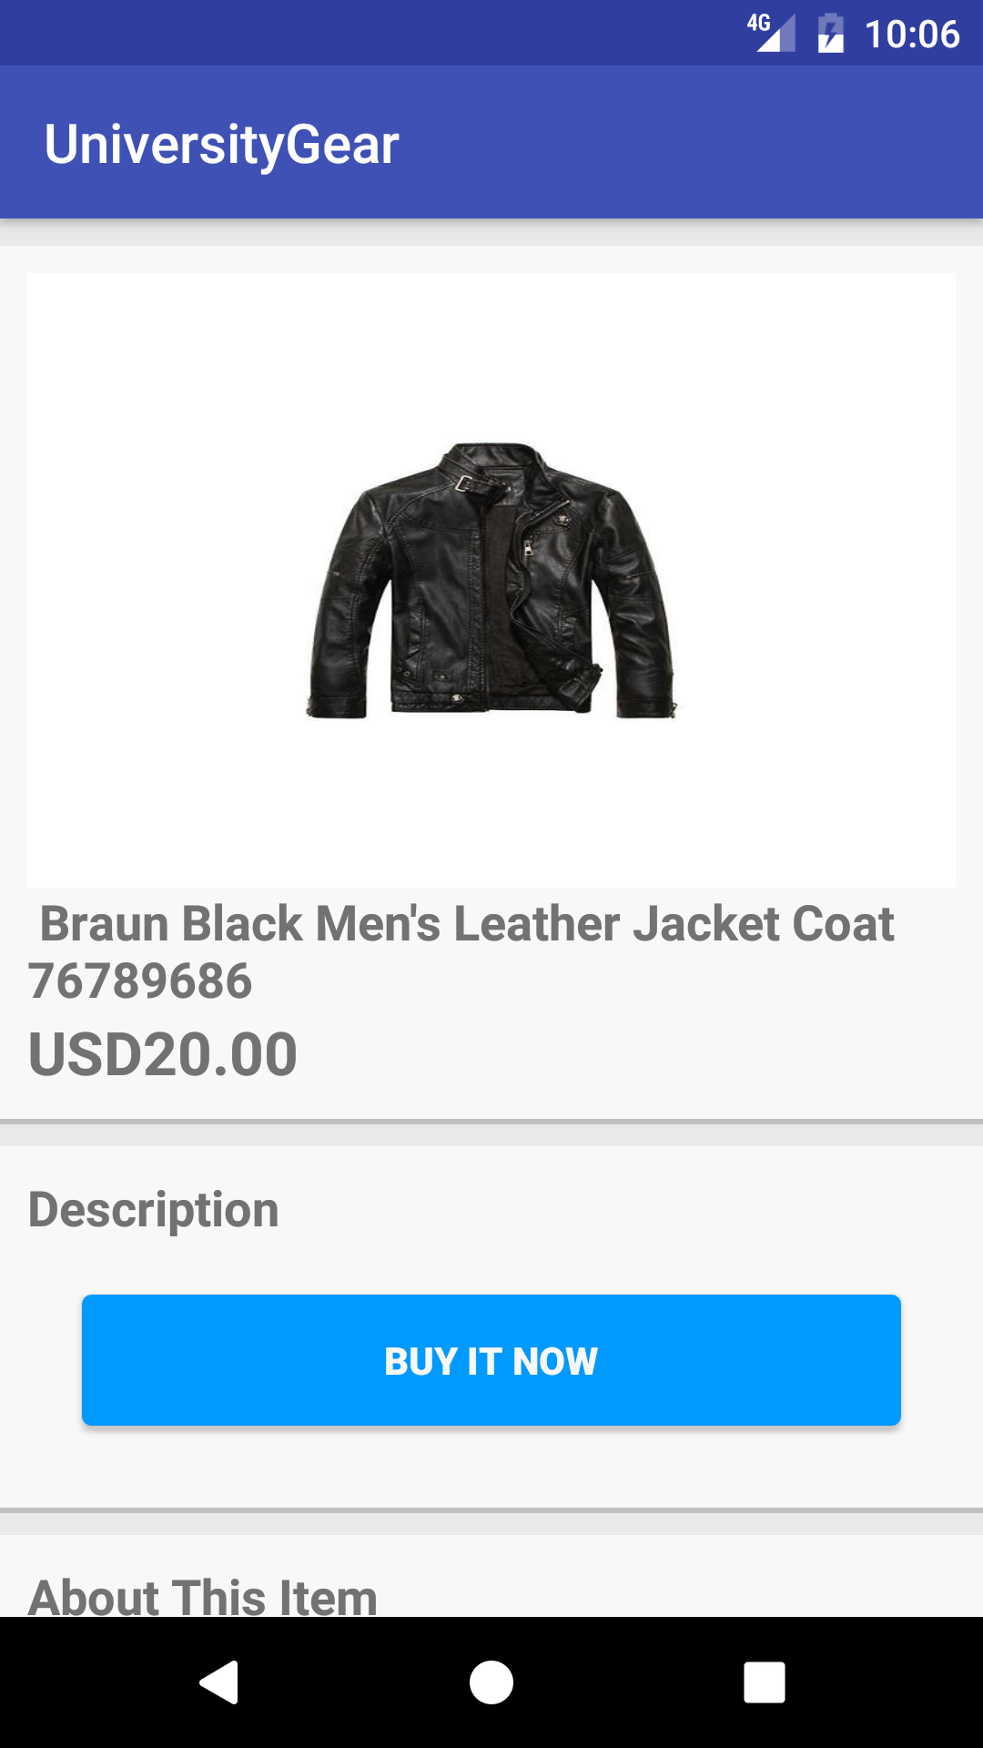
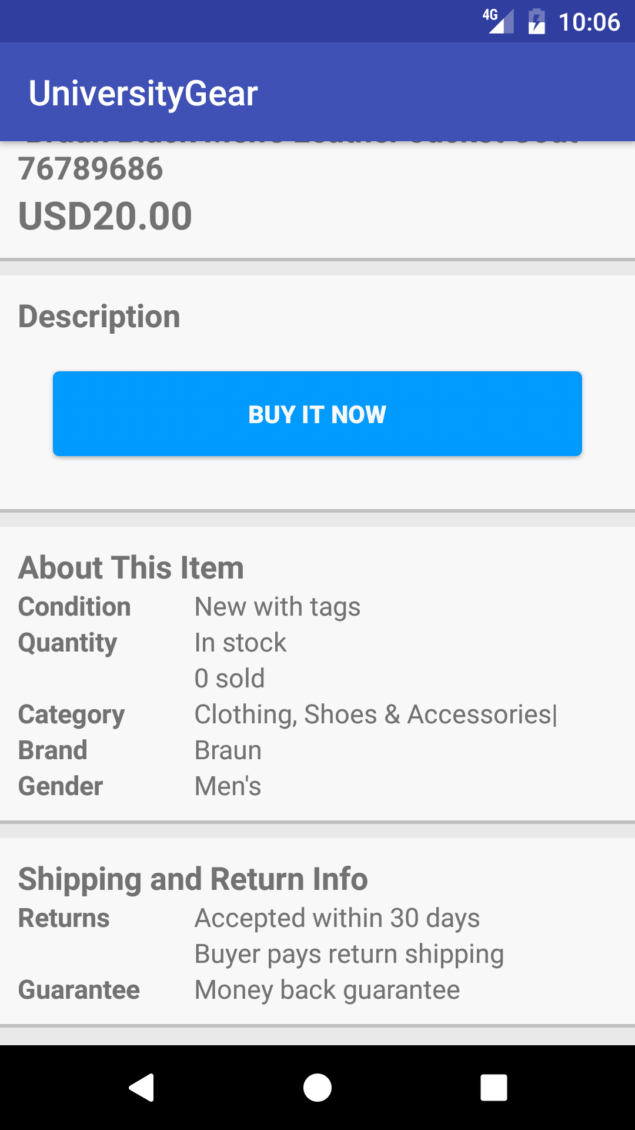
Images of single item view
Notes:
These images are taken from the single item view. Here, the user will be able to see specific details about the item that they have selected. Notice that there is an image, title, price, and description. The second image is what a user will see when they scroll down. It has other important information about the item as well as shipping and return info. However, the about item section is a bit dynamic in the sense that not every item will have the same fields. Some items won’t have brands or genders, for example.

Slide 21
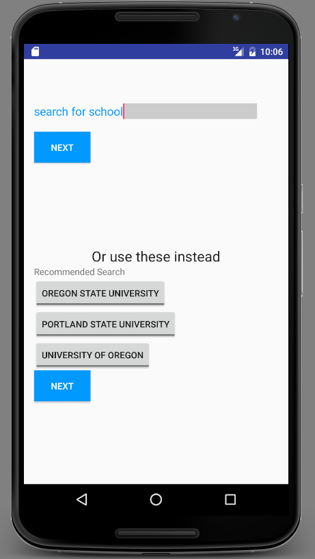
Search activity screen 1

Slide 22
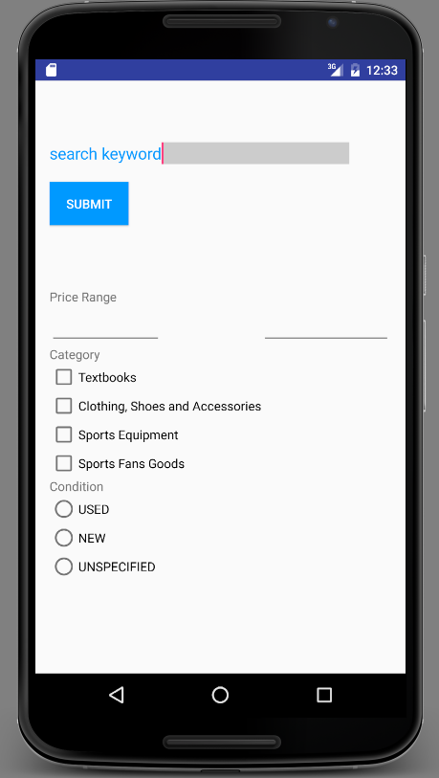
Search activity screen 2

Slide 23
Devin’s Winter Term Accomplishments
Learned how to use eBay’s API
Completed item class
Completed single item view activity
Completed the single item view’s UI
Notes:
I have accomplished many of the goals that I have set out to accomplish this
term.
So far,
I have managed to build the item class, which helps create items returned from
search results. I have also created an activity that lets users observe the
item they have selected in greater detail. This also came with a UI that I had
to develop.
The first thing that I had worked on this term was the item class. It wasn't
something that was very difficult to accomplish. It was more of a task in terms
of determining which data to use, as eBay's APIs provide a lot of information
on single items. It was important that this was one of the first classes that
needed to be created. This is because other parts of the project will heavily
depend upon this class. This class used the standard JSON methods that are
present in Java. These tools allowed me to parse and gather the correct
information that I needed, because all of the data returned by eBay's APIs are in
JSON format. However, the
item class is still expanding as we determine what information is important. So far, the class will return many things like the items title,
price, description, color, material, pattern, type, and category.
The next task that I accomplished was the creation of the single item activity.
This class allowed for a user to select and view a single item. It used the item
class to help build the single item. It also relied on eBay's Browse API. This
activity is started after a user selects a single item from the list view. From
there, it passes in the item id to the single item activity. The single item
activity then uses that item id in the eBay API. The API then returns a JSON file
with all of the information on the item. When searching for things like mugs, it
won't contain the same contents as a jacket would. A mug might only show the
fields material, while a jacket could have a pattern and a material field.
So the content displayed to the user is somewhat dynamic.
The UI for the single item activity resembles the style of the eBay app. The layout is rather
simple and it is easy to follow. It is broken into several sections. The first
section is the image, title, and price of the item. From there, we have the
description and the purchase button. Then there is the about section. It contains
the condition of the item, its quantity, category, brand, and other important
information. The last section is the shipping and return info. This section states
what kind of return policy the item has and how long a user will have to return the
item. It also specifies who pays for returns on the item.
I also helped my other team members accomplish some minor tasks. So far, I have helped
with merge conflicts. The beginning was a bit messy because we were all editing the
main activity as we needed. I also helped integrate the item class into the item list
view. For the remainder of the term, I have two things that I need to finish. First,
the purchase class needs to be developed. After that, I will return to the single
item activity UI to add a webview. This webview will be used so that users can
correctly view the description of an item, as some of the descriptions contain HTML
elements.

Slide 24
Hector’s Winter Term Accomplishments
Learned how to use eBay’s API
Completed home page UI
Completed item list view UI
Completed item list view activity
Notes:
I have been able to accomplish the major goals that I had set for this term. This includes the following:
I Worked with Bryan in implementing the application home page. Currently, the home page consists of a simple design that contains the search text box, the search button, and search filters. The users will be able to select filters right before they search to ensure that they get results that are relevant to them. I was also able to implement a progress bar that appears when the user submits their search. Once the search results are ready, the progress bar disappears. This lets users know that the application is working on retrieving their results.
The next item completed was the User Interface for the item list view. Here our goal was for the design to be simple but at the same time be informative and useful. Another UI goal was for it matched the rest of the application, and it was something that we were able to accomplish.
I also successfully completed the presentation of the search results in the list view for the users to scroll through. Presenting the details in the list view was done using the Item class that was implemented by Devin.
This list view displays the item's title, image, and price for every item that is returned. The user is allowed to scroll through the different items until they find one that catches their attention. This was an important feature because it lets the user scroll through search results in a user friendly manner that provides them with the most important information on an item. I also set up the "onClickListener" for each item so that when a user clicks on an item that they like, they get presented with more details.
I also implemented the alert notification that lets users know that their search criteria did not yield any results. The notification asks the user to try again using different keywords or filters. This again, is simple but important feature in that it keeps the user informed of what the application is doing, when it may appear that it is not functioning properly.

Slide 25
Bryan’s Winter Term Accomplishment
Learned a lot about RESTful API
Learn about authentication
Learn several practices that App creators use
Completed Search Activity and its UI
Completed Item filters

Slide 26
In conclusion…
We learned a lot about Android development
We will continue working on the remaining tasks
Notes:
In the end, we learned a lot about mobile development. We learned how to use RESTful APIs and how to create a somewhat decent UI.
However, we still have a lot to accomplish and we plan to reach our goals by the end of the term.

